Slide 1

Walchand College of Engineering, Sangli
Department of Information Technology
A
DP-IV
Presentation on
Performance evaluation of Fruit Fly Optimization
Algorithm on classical test problem set
Broad Topic: Engineering Optimization
Sub Topic: Evolutionary Algorithm
By Guide
Atul J. Kamble Dr. A. J. Umbarkar
M. Tech - II CSE(IT)

Slide 2
Outlines
Introduction
Research Objectives
Literature Survey
Research Gap
FFOA
Test Problem Set
Experimental Setting
Result and Analysis
References

Slide 3
Research Objectives
To implement FFOA to the classical test problem sets (CEC 2013)
To check the analysis of result of classical test problem.
To apply FFOA for engineering optimization problem.

Slide 4
Literature Survey
Sr. no. | Year | Applications of FFOA
1 | 2017 | Fruit Fly algorithm based clustering protocol in wireless sensor networks proposed by Anamika Dey, Tamal Sarkar, Sharafat Ali
2 | 2017 | Fault diagnosis of wind turbine gearbox by diminishing step fruit fly algorithm optimized SVM by Congzhi Huang, Yan Li, Tianyang Zhang
3 | 2016 | A multi-step prediction method for the network traffic based on echo state network advanced by quantum-behaved [4] Fruit Fly Optimization Algorithm.
4 | 2016 | A classifier based on the Least Square Support Vector Machine (LS-SVM) [7] with Fruit Fly Optimization Algorithm (FFOA) for polarimetric Synthetic Aperture Radar (SAR) image classification.
Table 2.1 Review on FFOA Applications

Slide 5
Literature Survey
Sr. no. | Year | Variants of FFOA
1 | 2018 | An improved fruit fly optimization algorithm (IFOA) is proposed to solve the traveling salesman problem by Zixiao Pan, Yang Chen, Wei Cheng
2 | 2017 | Jixiong Hu, Chunzhi Wang, Chuan Liu proposed Hybrid fruit fly optimization and differential evolution (DEFOA) by modifying the expression of the smell concentration judgment value and by introducing a differential vector to replace the stochastic search.
3 | 2017 | Multi-objective fruit fly optimization algorithm (MFOA) for test point selection by Qingfeng Ma, Yuzhu He, Fuqiang Zhou
4 | 2016 | Fruit Fly Algorithm Based on Extremal Optimization (EOFOA) proposed by Shuiping Zhang,Yang Chen,Yangdan Geng
5 | 2016 | In present day Iron and Steel Production Systems [1] production efficiency and profit can be increased by solving realistic hybrid flowshop rescheduling problem by reason Hybrid Fruit Fly Optimization Algorithm.
6 | 2016 | The Resource Constrained Unrelated Parallel Machine Green Manufacturing Scheduling Problem (RCUPMGSP) [2] with the criteria of limiting the makespan and the aggregate carbon emanation can be comprehended by Collaborative Multiobjective Fruit Fly Optimization Algorithm (CMFFOA).
7 | 2016 | Failure prognostics problem of the electronic system, Fast Relevance Vector Machine (FRVM) [3] method based on Improved Fruit Fly Optimization Algorithm (IFFOA) is proposed.
8 | 2016 | Test point selection problem issue settled by Multi-Objective Fruit Fly Optimization Algorithm (MOFFOA) [6].
Table 2.2 Reviews on Variants of FFOA

Slide 6
Literature Survey
Sr. No. | Authors | Work Carried out | Algorithm Used
1 | 2016 | Firefly algorithm existing leader fireflies: proposed FA to the conventional FA with benchmark functions of CEC 2013 | Firefly Algorithm
2 | 2017 | Enhancing Differential Evolution with Commensal Learning and Uniform Local Search: Comprehensive experiment results on all the CEC 2013 test suite and comparison with the state-of-the-art DE variants is done. | Differential evolution (DE) Algorithm
Table 2.3 CEC 2013 EA Literature Survey

Slide 7
Research Gap
Fruit Fly Optimization Algorithm was not tested on CEC test Benchmark Problem Set.
To Solve Truss bar, Gear Design Problem.

Slide 8
Introduction
Fruit Fly Optimization Algorithm (FFOA)
Proposed by (Pan,2012).
Inspired by the foraging behavior of fruit flies(Drosophila).
Has the ability to solve Complex Optimization Problems
Search pattern of fruit fly includes in sensitive osphresis [1] and flying towards location by vision.
Fig 1 : Drosophila body structure diagram[9]

Slide 9
Fruit Fly Optimization Algorithm
FOOD
Fly1(x1,y1)
Fly 2(X2,Y2)
Fly 3(X3,Y3)
(0,0)
Fig 2 : Schematic diagram of iterative search for food of fruit fly swarm

Slide 10
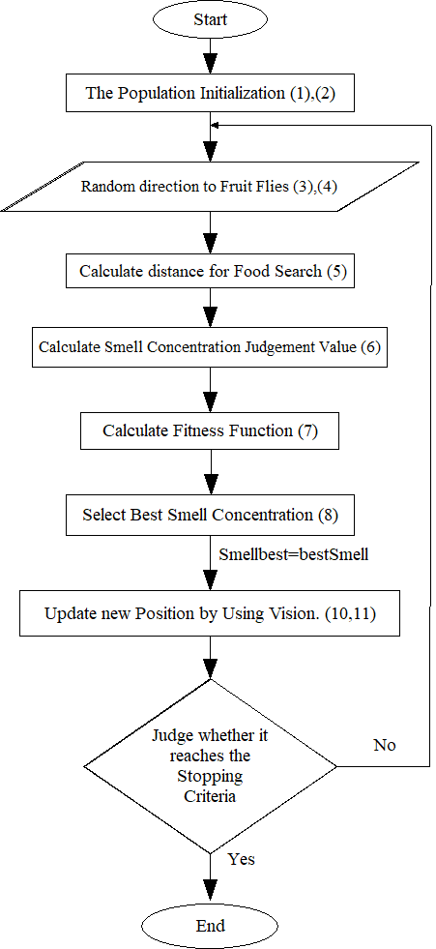
Fig 3: Flowchart of FFOA

Slide 11
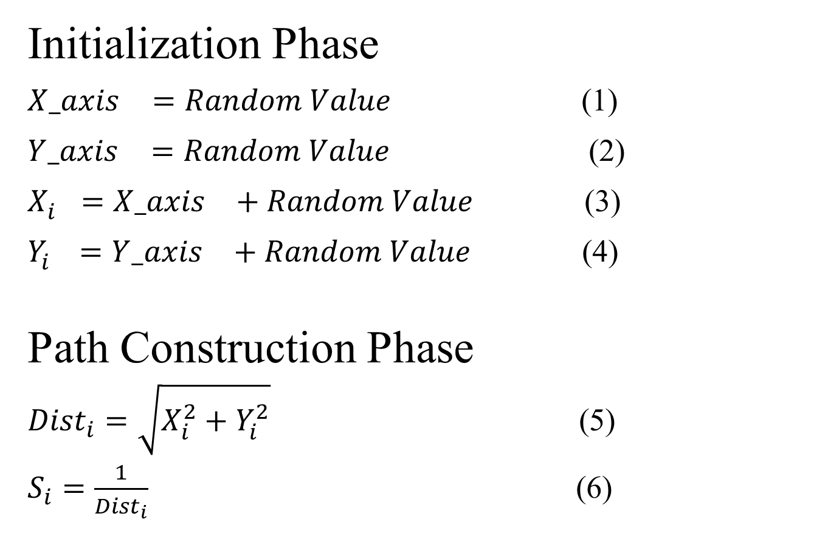
FFOA
Initialization Phase
${X_axis}_{}^{}=Random Value$ (1)
${Y_axis}_{}^{}=Random Value$ (2)
$X_{i}^{}={X_axis}_{}^{}+Random Value$ (3)
$Y_{i}^{}={Y_axis}_{}^{}+Random Value$ (4)
Path Construction Phase
${Dist}_{i}=\sqrt{X_{i}^{2}+Y_{i}^{2}}$ (5)
$S_{i}=\frac{1}{{Dist}_{i}}$ (6)

Slide 12
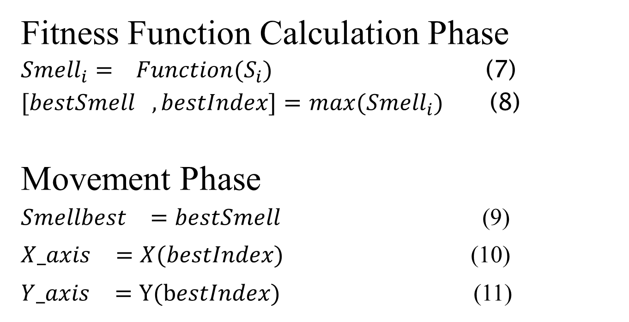
FFOA
Fitness Function Calculation Phase
${Smell}_{i}=$ ${Function(S}_{i})$ (7)
${[bestSmell}_{},bestIndex]=$ ${max(Smell}_{i})$ (8)
Movement Phase
${Smellbest}_{}=bestSmell$(9)
${X_axis}_{}^{}=X(bestIndex)$ (10)
${Y_axis}_{}^{}=Y(bestIndex)$ (11)

Slide 13
Summary of CEC’13 Expensive Optimization Test Problems (Unimodal Functions)
Properties:
U: Unimodal
M: Multimodal
C: Composite Functions,
S: Separable,
N: Non-separable,
A: Asymmetrical,
D: Different Properties Around Different Local Optima,
L: Local Optima's number is huge and second better local optimum is far from the global optimum
Table 1: Summary of CEC’13 Expensive Optimization Test Problems

Slide 14
Summary of CEC’13 Expensive Optimization Test Problems (Unimodal Functions)
No. | Functions | f_{i}*=f_{i}(x*) | Property
1 | Sphere Function | -1400 | US
2 | Rotated High Conditioned Elliptic Function | -1300 | UN
3 | Rotated Bent Cigar Function | -1200 | UN
4 | Rotated Discus Function | -1100 | UNA
5 | Different Powers Function | -1000 | US
 | Search Range: [-100,100]^{D}
Table 1: Summary of CEC’13 Expensive Optimization Test Problems

Slide 15
Summary of CEC’13 Expensive Optimization Test Problems (Basic Multimodal Functions)
No. | Functions | f_{i}*=f_{i}(x*) | Property
6 | Rotated Rosenbrock’s Function | -900 | MN
7 | Rotated Schaffers F7 Function | -800 | MNA
8 | Rotated Ackley’s Function | -700 | MNA
9 | Rotated Weierstrass Function | -600 | MNA
10 | Rotated Griewank’s Function | -500 | MN
11 | Rastrigin’s Function | -400 | MSA
12 | Rotated Rastrigin’s Function | -300 | MNA
13 | Non-Continuous Rotated Rastrigin’s Function | -200 | MNA
 | Search Range: [-100,100]^{D}
Table 2: Summary of CEC’13 Expensive Optimization Test Problems
15

Slide 16
Summary of CEC’13 Expensive Optimization Test Problems (Basic Multimodal Functions)
No. | Functions | f_{i}*=f_{i}(x*) | Property
14 | Schwefel's Function | -100 | MNAL
15 | Rotated Schwefel's Function | 100 | MNAL
16 | Rotated Katsuura Function | 200 | MNA
17 | Lunacek Bi_Rastrigin Function | 300 | MNA
18 | Rotated Lunacek Bi_Rastrigin Function | 400 | MNA
19 | Expanded Griewank’s plus Rosenbrock’s Function | 500 | MN
20 | Expanded Scaffer’s F6 Function | 600 | MNA
 | Search Range: [-100,100]^{D}
16
16
Table 2: Summary of CEC’13 Expensive Optimization Test Problems

Slide 17
Summary of CEC’13 Expensive Optimization Test Problems (Composite Functions)
No. | Functions | f_{i}*=f_{i}(x*) | Property
21 | Composition Function 1 (n=5,Rotated) | 700 | CMNAD
22 | Composition Function 2(n=3,Unrotated) | 800 | CMSAD
23 | Composition Function 3 (n=3,Rotated) | 900 | CMNAD
24 | Composition Function 4 (n=3,Rotated) | 1000 | CMNAD
25 | Composition Function 5 (n=3,Rotated) | 1100 | CMNAD
26 | Composition Function 6 (n=5,Rotated) | 1200 | CMNAD
27 | Composition Function 7 (n=5,Rotated) | 1300 | CMNAD
28 | Composition Function 8 (n=5,Rotated) | 1400 | CMNAD
 | Search Range: [-100,100]^{D}
Table 3: Summary of CEC’13 Expensive Optimization Test Problems

Slide 18
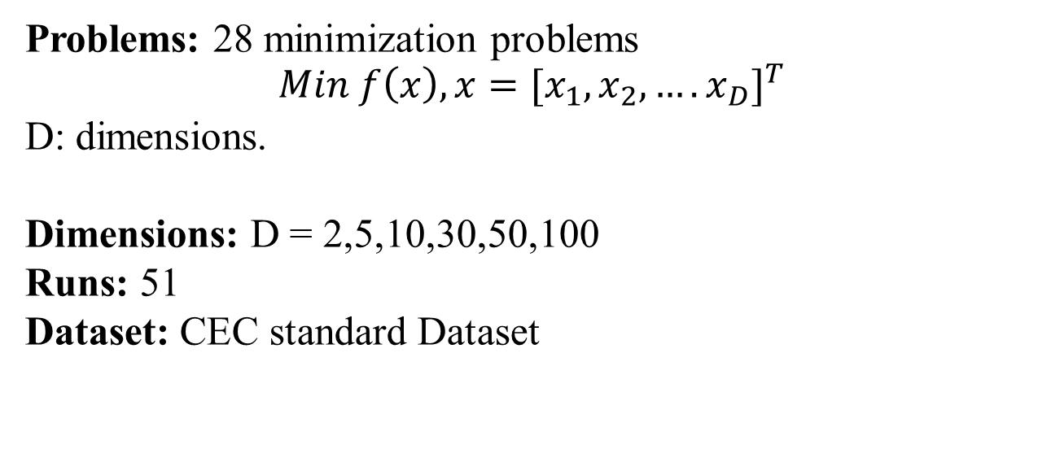
Experimental Setting
Problems: 28 minimization problems
$$Min f\left(x\right), x={{[x}_{1},x_{2},….x_{D}]}^{T}$$
D: dimensions.
Dimensions: D = 2,5,10,30,50,100
Runs: 51
Dataset: CEC standard Dataset

Slide 19
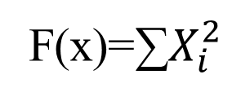
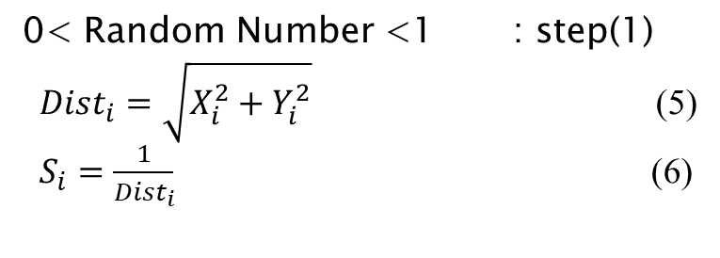
FFOA for Min Function ∑$X_{i}^{2}$
F(x)=∑$X_{i}^{2}$
Fitness Function =
0< Random Number <1 : step(1)
${Dist}_{i}=\sqrt{X_{i}^{2}+Y_{i}^{2}}$ (5)
$S_{i}=\frac{1}{{Dist}_{i}}$ (6)

Slide 20
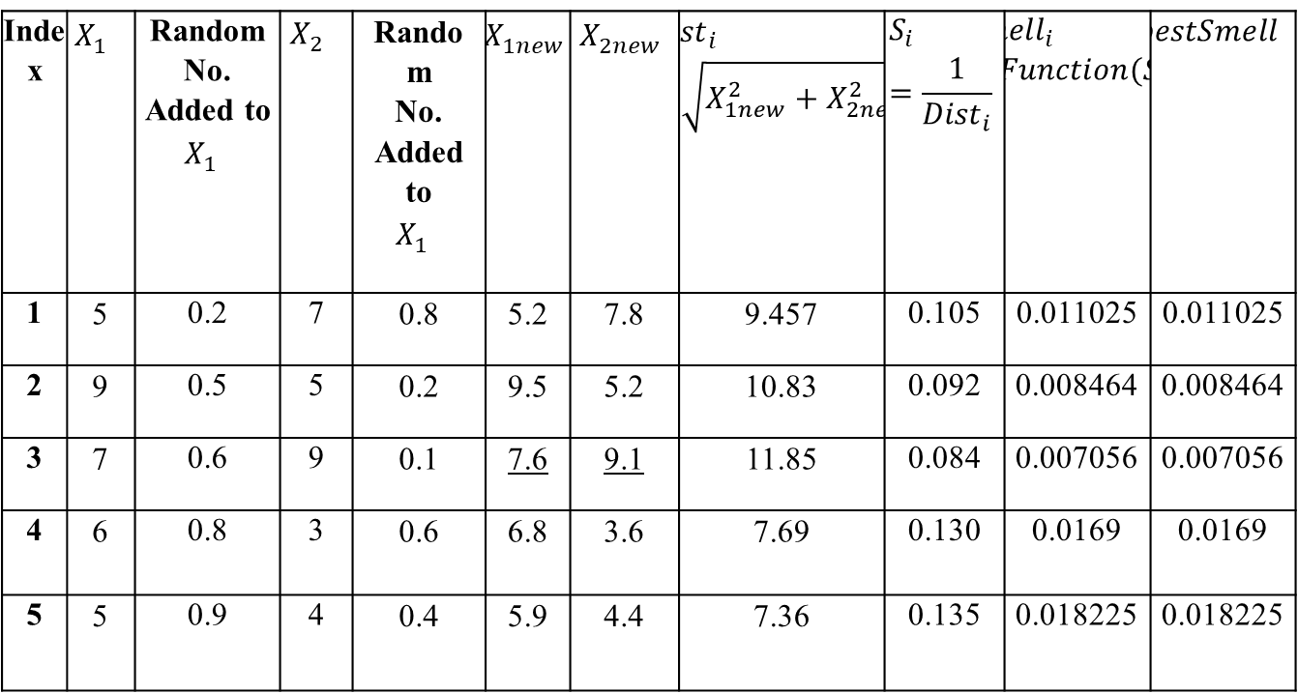
FFOA for Min Function ∑$X_{i}^{2}$
Itearation 1
Index | $$X_{1}^{}$$ | Random No. Added to $$X_{1}^{}$$ | $$X_{2}^{}$$ | Random No. Added to $$X_{1}^{}$$ | $$X_{1new}^{}$$ | $$X_{2new}^{}$$ | $${Dist}_{i}=\sqrt{X_{1new}^{2}+X_{2new}^{2}}$$ | $$S_{i}=\frac{1}{{Dist}_{i}}$$ | $${Smell}_{i}={Function(S}_{i})$$ | $${bestSmell}_{}$$
1 | 5 | 0.2 | 7 | 0.8 | 5.2 | 7.8 | 9.457 | 0.105 | 0.011025 | 0.011025
2 | 9 | 0.5 | 5 | 0.2 | 9.5 | 5.2 | 10.83 | 0.092 | 0.008464 | 0.008464
3 | 7 | 0.6 | 9 | 0.1 | 7.6 | 9.1 | 11.85 | 0.084 | 0.007056 | 0.007056
4 | 6 | 0.8 | 3 | 0.6 | 6.8 | 3.6 | 7.69 | 0.130 | 0.0169 | 0.0169
5 | 5 | 0.9 | 4 | 0.4 | 5.9 | 4.4 | 7.36 | 0.135 | 0.018225 | 0.018225

Slide 21
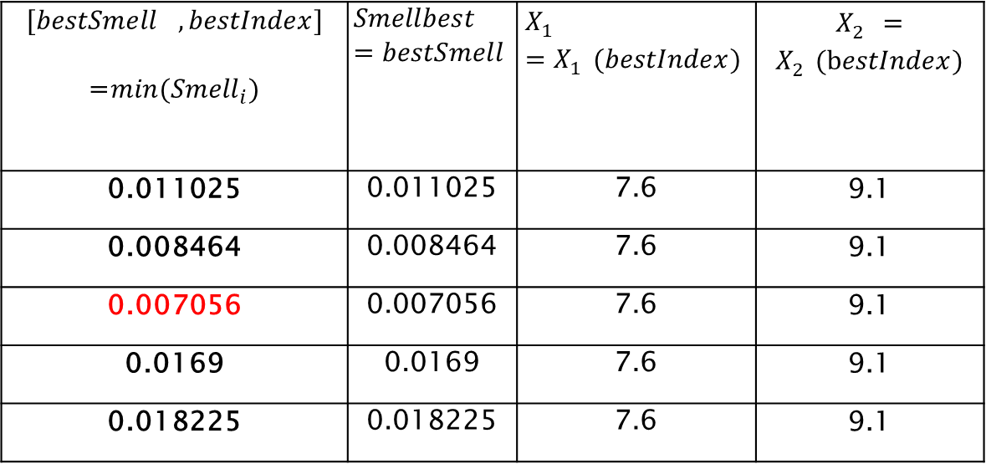
FFOA for Min Function ∑$X_{i}^{2}$
FFOA for Minimization of Function ∑Xi2
0 << Random Number << 1
Iteration 1
$${[bestSmell}_{},bestIndex]$$ =${min(Smell}_{i})$ | $${Smellbest}_{}=bestSmell$$ | $$X_{1}^{}=X_{1}^{}(bestIndex)$$ | $X_{2}^{}=X_{2}^{}(bestIndex)$
0.011025 | 0.011025 | 7.6 | 9.1
0.008464 | 0.008464 | 7.6 | 9.1
0.007056 | 0.007056 | 7.6 | 9.1
0.0169 | 0.0169 | 7.6 | 9.1
0.018225 | 0.018225 | 7.6 | 9.1

Slide 22
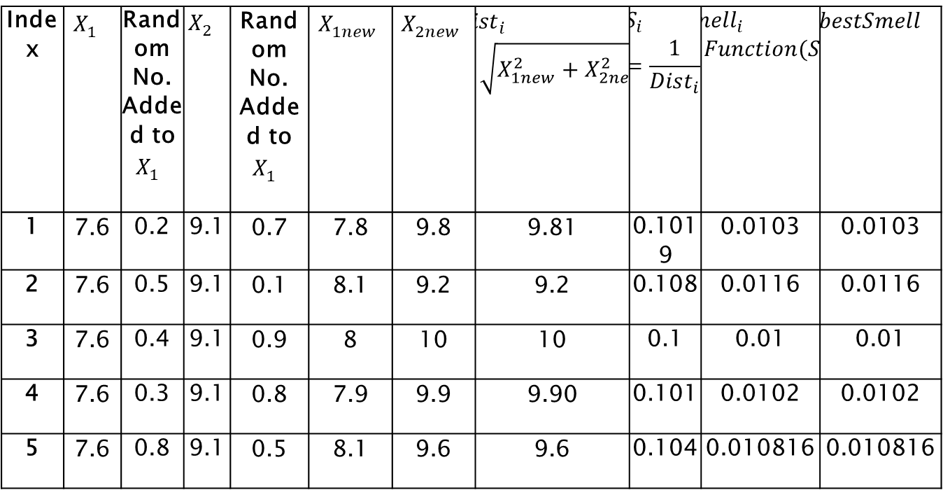
FFOA for Min Function ∑$X_{i}^{2}$
Iteration 2
Index | $$X_{1}^{}$$ | Random No. Added to $$X_{1}^{}$$ | $$X_{2}^{}$$ | Random No. Added to $$X_{1}^{}$$ | $$X_{1new}^{}$$ | $$X_{2new}^{}$$ | $${Dist}_{i}=\sqrt{X_{1new}^{2}+X_{2new}^{2}}$$ | $$S_{i}=\frac{1}{{Dist}_{i}}$$ | $${Smell}_{i}={Function(S}_{i})$$ | $${bestSmell}_{}$$
1 | 7.6 | 0.2 | 9.1 | 0.7 | 7.8 | 9.8 | 9.81 | 0.1019 | 0.0103 | 0.0103
2 | 7.6 | 0.5 | 9.1 | 0.1 | 8.1 | 9.2 | 9.2 | 0.108 | 0.0116 | 0.0116
3 | 7.6 | 0.4 | 9.1 | 0.9 | 8 | 10 | 10 | 0.1 | 0.01 | 0.01
4 | 7.6 | 0.3 | 9.1 | 0.8 | 7.9 | 9.9 | 9.90 | 0.101 | 0.0102 | 0.0102
5 | 7.6 | 0.8 | 9.1 | 0.5 | 8.1 | 9.6 | 9.6 | 0.104 | 0.010816 | 0.010816

Slide 23
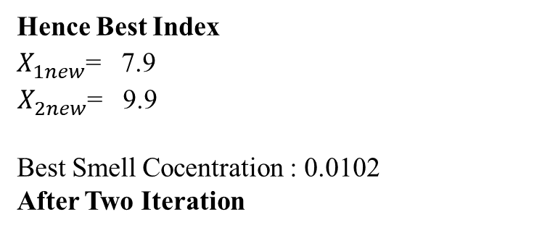
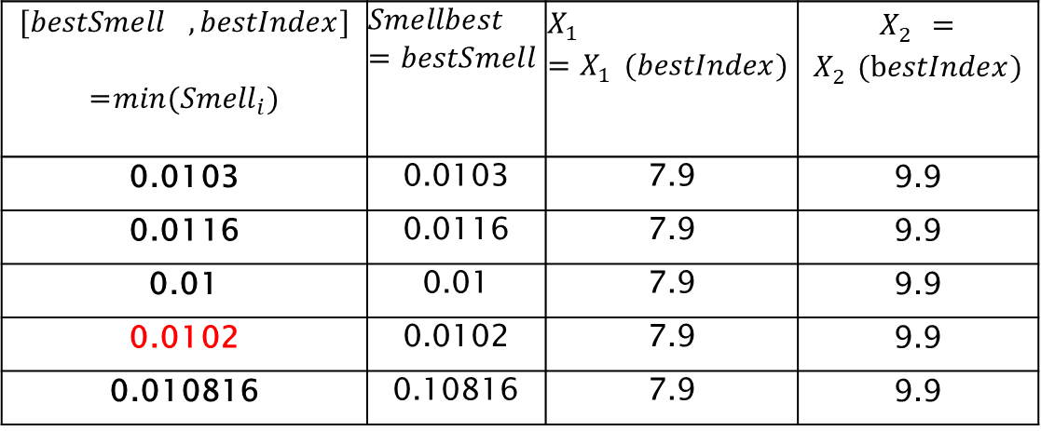
FFOA for Min Function ∑$X_{i}^{2}$
$${[bestSmell}_{},bestIndex]$$ =${min(Smell}_{i})$ | $${Smellbest}_{}=bestSmell$$ | $$X_{1}^{}=X_{1}^{}(bestIndex)$$ | $X_{2}^{}=X_{2}^{}(bestIndex)$
0.0103 | 0.0103 | 7.9 | 9.9
0.0116 | 0.0116 | 7.9 | 9.9
0.01 | 0.01 | 7.9 | 9.9
0.0102 | 0.0102 | 7.9 | 9.9
0.010816 | 0.10816 | 7.9 | 9.9
Hence Best Index
$X_{1new}^{}$= 7.9 $X_{2new}^{}$= 9.9
Best Smell Cocentration : 0.0102
After Two Iteration

Slide 24
Result:2D FFOA for CEC 2013
Function No. | Ideal Values | Best | Worst | Median | Mean | Std
1 | -1.40000E+03 | -1.40000E+03 | -1.40000E+03 | -1.40000E+03 | -1.40000E+03 | 1.09000E-05
2 | -1.30000E+03 | -1.30000E+03 | -1.30000E+03 | -1.30000E+03 | -1.30000E+03 | 1.26000E-01
3 | -1.20000E+03 | -1.20000E+03 | -1.20000E+03 | -1.20000E+03 | -1.20000E+03 | 1.42000E-01
4 | -1.10000E+03 | -1.10000E+03 | -1.08000E+03 | -1.09979E+03 | -1.09000E+03 | 7.45000E+00
5 | -1.00000E+03 | -1.00000E+03 | -1.00000E+03 | -1.00000E+03 | -1.00000E+03 | 1.15000E-05
6 | -9.00000E+02 | -9.00000E+02 | -9.00000E+02 | -9.00000E+02 | -9.00000E+02 | 9.71000E-09
7 | -8.00000E+02 | -8.00000E+02 | -8.00000E+02 | -8.00000E+02 | -8.00000E+02 | 1.20000E-03
8 | -7.00000E+02 | -7.00000E+02 | -6.98000E+02 | -6.79641E+02 | -6.99000E+02 | 7.70000E-01
9 | -6.00000E+02 | -6.00000E+02 | -5.99000E+02 | -5.99089E+02 | -6.00000E+02 | 4.17000E-01
10 | -5.00000E+02 | -5.00000E+02 | -5.00000E+02 | -4.99951E+02 | -5.00000E+02 | 4.73000E-04
11 | -4.00000E+02 | -4.00000E+02 | -4.00000E+02 | -3.95025E+02 | -4.00000E+02 | 1.40000E-07
12 | -3.00000E+02 | -3.00000E+02 | -2.99000E+02 | -2.92554E+02 | -3.00000E+02 | 4.00000E-01
13 | -2.00000E+02 | -2.00000E+02 | -2.00000E+02 | -1.90685E+02 | -2.00000E+02 | 1.61000E-07
14 | -1.00000E+02 | -1.00000E+02 | -9.70000E+01 | 4.77333E+01 | -9.85000E+01 | 1.49000E+00
15 | 1.00000E+02 | 1.00000E+02 | 1.01000E+02 | 1.41184E+02 | 1.01000E+02 | 5.61000E-01
16 | 2.00000E+02 | 2.00000E+02 | 2.01000E+02 | 2.00917E+02 | 2.01000E+02 | 5.06000E-01
17 | 3.00000E+02 | 3.00000E+02 | 3.02000E+02 | 3.15248E+02 | 3.01000E+02 | 1.08000E+00
18 | 4.00000E+02 | 4.02000E+02 | 4.04000E+02 | 4.28048E+02 | 4.03000E+02 | 8.04000E-01
19 | 5.00000E+02 | 5.00000E+02 | 5.00000E+02 | 5.00616E+02 | 5.00000E+02 | 8.87000E-02
20 | 6.00000E+02 | 6.00000E+02 | 6.00000E+02 | 6.02246E+02 | 6.00000E+02 | 1.47000E-06
21 | 7.00000E+02 | 7.15000E+02 | 7.45000E+02 | 1.10019E+03 | 7.30000E+02 | 1.46000E+01
22 | 8.00000E+02 | 8.00000E+02 | 8.00000E+02 | 1.05277E+03 | 8.00000E+02 | 6.75000E-02
23 | 9.00000E+02 | 9.00000E+02 | 9.18000E+02 | 1.80258E+03 | 9.09000E+02 | 9.11000E+00
24 | 1.00000E+03 | 1.00000E+03 | 1.00000E+03 | 1.20685E+03 | 1.00000E+03 | 2.40000E-01
25 | 1.10000E+03 | 1.10000E+03 | 1.11000E+03 | 1.30454E+03 | 1.10000E+03 | 3.24000E+00
26 | 1.20000E+03 | 1.20000E+03 | 1.20000E+03 | 1.40002E+03 | 1.20000E+03 | 2.14000E+00
27 | 1.30000E+03 | 1.32000E+03 | 1.39000E+03 | 1.60000E+03 | 1.36000E+03 | 3.58000E+01
28 | 1.40000E+03 | 1.40000E+03 | 1.46000E+03 | 1.70000E+03 | 1.43000E+03 | 2.97000E+01
Fig 3 : FFOA for CEC 2013 (2D)

Slide 25
Result Analysis 2D FFOA for CEC 2013
Fig 3 : FFOA for CEC 2013 (2D)

Slide 26
Result:5D FFOA for CEC 2013
Function No. | Ideal Values | Best | Worst | Median | Mean | Std
1 | -1.400000E+03 | -1.400000E+03 | -1.400000E+03 | -1.400000E+03 | -1.400000E+03 | 3.350000E-01
2 | -1.300000E+03 | -1.290000E+03 | -1.270000E+03 | -1.300000E+03 | -1.280000E+03 | 1.190000E+01
3 | -1.200000E+03 | -1.120000E+03 | -9.400000E+02 | -1.199996E+03 | -1.030000E+03 | 9.140000E+01
4 | -1.100000E+03 | -1.070000E+03 | -9.450000E+02 | -1.099789E+03 | -9.920000E+02 | 4.970000E+00
5 | -1.000000E+03 | -9.990000E+02 | -9.640000E+02 | -1.000000E+03 | -9.820000E+02 | 2.330000E-01
6 | -9.000000E+02 | -9.000000E+02 | -8.970000E+02 | -9.000000E+02 | -8.980000E+02 | 5.520000E-01
7 | -8.000000E+02 | -7.990000E+02 | -7.920000E+02 | -7.999999E+02 | -7.960000E+02 | 3.100000E-01
8 | -7.000000E+02 | -6.850000E+02 | -6.800000E+02 | -6.796405E+02 | -6.830000E+02 | 2.560000E+00
9 | -6.000000E+02 | -5.990000E+02 | -5.980000E+02 | -5.990890E+02 | -5.980000E+02 | 6.690000E-01
10 | -5.000000E+02 | -4.990000E+02 | -4.990000E+02 | -4.999508E+02 | -4.990000E+02 | 4.420000E-02
11 | -4.000000E+02 | -3.980000E+02 | -3.970000E+02 | -3.950252E+02 | -3.980000E+02 | 7.450000E-01
12 | -3.000000E+02 | -2.980000E+02 | -2.970000E+02 | -2.925535E+02 | -2.970000E+02 | 2.360000E-01
13 | -2.000000E+02 | -1.980000E+02 | -1.980000E+02 | -1.906853E+02 | -1.980000E+02 | 3.650000E-03
14 | -1.000000E+02 | -5.620000E+01 | -1.010000E+01 | 4.773330E+01 | -3.310000E+01 | 2.310000E+01
15 | 1.000000E+02 | 1.390000E+02 | 1.590000E+02 | 1.411841E+02 | 1.490000E+02 | 9.780000E+00
16 | 2.000000E+02 | 2.000000E+02 | 2.000000E+02 | 2.009166E+02 | 2.000000E+02 | 4.860000E-02
17 | 3.000000E+02 | 3.230000E+02 | 3.560000E+02 | 3.152484E+02 | 3.400000E+02 | 1.650000E+01
18 | 4.000000E+02 | 4.050000E+02 | 4.100000E+02 | 4.280475E+02 | 4.070000E+02 | 2.290000E+00
19 | 5.000000E+02 | 5.030000E+02 | 5.070000E+02 | 5.006155E+02 | 5.050000E+02 | 1.670000E+00
20 | 6.000000E+02 | 6.010000E+02 | 6.010000E+02 | 6.022459E+02 | 6.010000E+02 | 2.000000E-01
21 | 7.000000E+02 | 8.020000E+02 | 8.420000E+02 | 1.100194E+03 | 8.260000E+02 | 2.380000E+01
22 | 8.000000E+02 | 1.020000E+03 | 1.090000E+03 | 1.052768E+03 | 1.060000E+03 | 3.130000E+01
23 | 9.000000E+02 | 1.200000E+03 | 1.290000E+03 | 1.802578E+03 | 1.240000E+03 | 4.490000E+01
24 | 1.000000E+03 | 1.000000E+03 | 1.100000E+03 | 1.206853E+03 | 1.050000E+03 | 4.620000E+01
25 | 1.100000E+03 | 1.210000E+03 | 1.230000E+03 | 1.304540E+03 | 1.220000E+03 | 6.370000E+00
26 | 1.200000E+03 | 1.290000E+03 | 1.320000E+03 | 1.400017E+03 | 1.300000E+03 | 1.420000E+01
27 | 1.300000E+03 | 1.650000E+03 | 1.680000E+03 | 1.600000E+03 | 1.670000E+03 | 1.540000E+01
28 | 1.400000E+03 | 1.570000E+03 | 1.620000E+03 | 1.700000E+03 | 1.590000E+03 | 2.700000E+01
Fig 3 : FFOA for CEC 2013 (5D)

Slide 27
Result Analysis 5D FFOA for CEC 2013
Fig 3 : FFOA for CEC 2013 (5D)

Slide 28
Result:10D FFOA for CEC 2013
Function No. | Ideal Values | Best | Worst | Median | Mean | Std
1 | -1.400000E+03 | -1.400000E+03 | -1.400000E+03 | -1.400000E+03 | -1.400000E+03 | 0.000000E+00
2 | -1.300000E+03 | -1.300000E+03 | -1.299033E+03 | -1.300000E+03 | -1.299981E+03 | 1.354708E-01
3 | -1.200000E+03 | -1.200000E+03 | -1.193685E+03 | -1.199996E+03 | -1.199783E+03 | 9.111924E-01
4 | -1.100000E+03 | -1.100000E+03 | 1.392144E+04 | -1.099789E+03 | 1.601910E+02 | 2.811845E+03
5 | -1.000000E+03 | -1.000000E+03 | -1.000000E+03 | -1.000000E+03 | -1.000000E+03 | 0.000000E+00
6 | -9.000000E+02 | -9.000000E+02 | -8.901876E+02 | -9.000000E+02 | -8.967292E+02 | 4.671648E+00
7 | -8.000000E+02 | -8.000000E+02 | -7.989574E+02 | -7.999999E+02 | -7.999733E+02 | 1.505396E-01
8 | -7.000000E+02 | -6.799071E+02 | -6.795016E+02 | -6.796405E+02 | -6.796498E+02 | 9.057597E-02
9 | -6.000000E+02 | -6.000000E+02 | -5.939606E+02 | -5.990890E+02 | -5.981038E+02 | 2.039430E+00
10 | -5.000000E+02 | -5.000000E+02 | -4.998304E+02 | -4.999508E+02 | -4.999430E+02 | 3.321407E-02
11 | -4.000000E+02 | -4.000000E+02 | -3.850757E+02 | -3.950252E+02 | -3.950240E+02 | 3.072043E+00
12 | -3.000000E+02 | -2.980101E+02 | -2.837338E+02 | -2.925535E+02 | -2.923077E+02 | 3.623067E+00
13 | -2.000000E+02 | -1.980101E+02 | -1.744430E+02 | -1.906853E+02 | -1.904751E+02 | 5.201004E+00
14 | -1.000000E+02 | -6.445826E+01 | 2.434354E+02 | 4.773330E+01 | 5.107030E+01 | 8.122281E+01
15 | 1.000000E+02 | 6.999870E+01 | 2.138550E+02 | 1.411841E+02 | 1.412723E+02 | 4.126900E+00
16 | 2.000000E+02 | 2.005308E+02 | 2.013531E+02 | 2.009166E+02 | 2.009089E+02 | 1.866440E-01
17 | 3.000000E+02 | 3.125662E+02 | 3.273021E+02 | 3.152484E+02 | 3.158886E+02 | 2.920728E+00
18 | 4.000000E+02 | 4.196691E+02 | 4.336004E+02 | 4.280475E+02 | 4.276111E+02 | 3.084152E+00
19 | 5.000000E+02 | 5.004288E+02 | 5.011969E+02 | 5.006155E+02 | 5.006425E+02 | 1.527774E-01
20 | 6.000000E+02 | 6.015881E+02 | 6.031719E+02 | 6.022459E+02 | 6.023526E+02 | 4.131306E-01
21 | 7.000000E+02 | 9.000000E+02 | 1.100194E+03 | 1.100194E+03 | 1.068791E+03 | 7.352921E+01
22 | 8.000000E+02 | 8.240856E+02 | 1.366504E+03 | 1.052768E+03 | 1.062227E+03 | 1.171920E+02
23 | 9.000000E+02 | 1.008160E+03 | 2.324677E+03 | 1.802578E+03 | 1.804207E+03 | 2.179051E+02
24 | 1.000000E+03 | 1.111457E+03 | 1.215937E+03 | 1.206853E+03 | 1.205280E+03 | 1.375281E+01
25 | 1.100000E+03 | 1.300000E+03 | 1.313219E+03 | 1.304540E+03 | 1.304126E+03 | 3.765429E+00
26 | 1.200000E+03 | 1.303980E+03 | 1.400017E+03 | 1.400017E+03 | 1.383830E+03 | 3.533316E+01
27 | 1.300000E+03 | 1.600000E+03 | 1.849954E+03 | 1.600000E+03 | 1.677045E+03 | 9.380240E+01
28 | 1.400000E+03 | 1.500000E+03 | 1.700000E+03 | 1.700000E+03 | 1.688235E+03 | 4.752708E+01
Fig 3 : FFOA for CEC 2013 (10D)

Slide 29
Result Analysis 10D FFOA for CEC 2013
Fig 3 : FFOA for CEC 2013 (10D)

Slide 30
Result:30D FFOA for CEC 2013
Function No. | Ideal Values | Best | Worst | Median | Mean | Std
1 | -1.400000E+03 | -1.400000E+03 | -1.400000E+03 | -1.400000E+03 | -1.400000E+03 | 0.000000E+00
2 | -1.300000E+03 | -1.300590E+03 | -1.297000E+03 | -1.298450E+03 | -1.298500E+03 | 1.500000E+00
3 | -1.200000E+03 | -1.196254E+03 | -1.100960E+03 | -8.782366E+02 | -1.100008E+03 | 1.356000E+00
4 | -1.100000E+03 | -1.055790E+03 | -1.053450E+03 | -1.052640E+03 | -1.052470E+03 | 3.130000E-01
5 | -1.000000E+03 | -1.000000E+03 | -1.000000E+03 | -1.000000E+03 | -1.000000E+03 | 1.861720E-07
6 | -9.000000E+02 | -8.999856E+02 | -8.735926E+02 | -8.928575E+02 | -8.917063E+02 | 5.816643E+00
7 | -8.000000E+02 | -7.997932E+02 | -7.926696E+02 | -7.990602E+02 | -7.987097E+02 | 1.216569E+00
8 | -7.000000E+02 | -6.791742E+02 | -6.789735E+02 | -6.790431E+02 | -6.790543E+02 | 4.818177E-02
9 | -6.000000E+02 | -5.982051E+02 | -5.738326E+02 | -5.938729E+02 | -5.937026E+02 | 3.273640E+00
10 | -5.000000E+02 | -5.000000E+02 | -4.999409E+02 | -4.999803E+02 | -4.999784E+02 | 1.355836E-02
11 | -4.000000E+02 | -3.610831E+02 | -3.137433E+02 | -3.431496E+02 | -3.415816E+02 | 1.109845E+01
12 | -3.000000E+02 | -2.134473E+02 | -1.615283E+02 | -1.845535E+02 | -1.850140E+02 | 1.140316E+01
13 | -2.000000E+02 | -9.666010E+01 | -4.023150E+01 | -6.902010E+01 | -6.929100E+01 | 1.243390E+01
14 | -1.000000E+02 | -8.390900E+01 | -4.343600E+01 | -4.237700E+01 | -4.227200E+01 | 1.656000E-01
15 | 1.000000E+02 | 9.742300E+01 | 9.948400E+01 | 9.880500E+01 | 9.865500E+01 | 5.735000E-01
16 | 2.000000E+02 | 2.016840E+02 | 2.029488E+02 | 2.023929E+02 | 2.023914E+02 | 2.656246E-01
17 | 3.000000E+02 | 3.800017E+02 | 4.311822E+02 | 4.026442E+02 | 4.018197E+02 | 1.174836E+01
18 | 4.000000E+02 | 5.442016E+02 | 6.060728E+02 | 5.820659E+02 | 5.823109E+02 | 1.198835E+01
19 | 5.000000E+02 | 5.040439E+02 | 5.087070E+02 | 5.053288E+02 | 5.053964E+02 | 8.098072E-01
20 | 6.000000E+02 | 6.107105E+02 | 6.119675E+02 | 6.112685E+02 | 6.113232E+02 | 3.275456E-01
21 | 7.000000E+02 | 9.000000E+02 | 1.143544E+03 | 1.000000E+03 | 1.019449E+03 | 6.263432E+01
22 | 8.000000E+02 | 8.218600E+02 | 8.259810E+02 | 8.239020E+02 | 8.233850E+02 | 7.260000E-02
23 | 9.000000E+02 | 9.733720E+02 | 9.762860E+02 | 9.752030E+02 | 9.742670E+02 | 3.034000E-01
24 | 1.000000E+03 | 1.200542E+03 | 1.206094E+03 | 1.201800E+03 | 1.202337E+03 | 1.395566E+00
25 | 1.100000E+03 | 1.300418E+03 | 1.357542E+03 | 1.340203E+03 | 1.329548E+03 | 2.077473E+01
26 | 1.200000E+03 | 1.400001E+03 | 1.516088E+03 | 1.400042E+03 | 1.418430E+03 | 4.011718E+01
27 | 1.300000E+03 | 1.605996E+03 | 1.660942E+03 | 1.622538E+03 | 1.625587E+03 | 1.141857E+01
28 | 1.400000E+03 | 1.700000E+03 | 1.700000E+03 | 1.700000E+03 | 1.700000E+03 | 2.235430E-05
Fig 3 : FFOA for CEC 2013 (30D)

Slide 31
Result Analysis 30D FFOA for CEC 2013
Fig 3 : FFOA for CEC 2013 (30D)

Slide 32
Result:50D FFOA for CEC 2013
Function No. | Ideal Values | Best | Worst | Median | Mean | Std
1 | -1.400000E+03 | -1.400000E+03 | -1.400000E+03 | -1.400000E+03 | -1.400000E+03 | 0.000000E+00
2 | -1.300000E+03 | -1.342940E+03 | -1.345800E+03 | -1.343700E+03 | #NAME? | 9.300000E-01
3 | -1.200000E+03 | -1.195600E+03 | -1.197000E+03 | -1.196500E+03 | -1.196300E+03 | 3.000000E-01
4 | -1.100000E+03 | -1.028921E+03 | -6.003850E+02 | -9.056808E+02 | -8.795812E+02 | 9.580094E+01
5 | -1.000000E+03 | -9.999999E+02 | -9.999877E+02 | -9.999991E+02 | -9.999986E+02 | 1.865128E-03
6 | -9.000000E+02 | -8.748870E+02 | -7.520614E+02 | -8.127672E+02 | -8.264399E+02 | 2.802272E+01
7 | -8.000000E+02 | -7.915203E+02 | -7.477172E+02 | -7.809010E+02 | -7.792758E+02 | 9.158269E+00
8 | -7.000000E+02 | -6.789882E+02 | -6.788014E+02 | -6.788600E+02 | -6.788616E+02 | 3.534520E-02
9 | -6.000000E+02 | -5.810790E+02 | -5.665711E+02 | -5.734504E+02 | -5.739693E+02 | 3.048047E+00
10 | -5.000000E+02 | -4.999523E+02 | -4.988432E+02 | -4.993799E+02 | -4.994010E+02 | 3.427160E-01
11 | -4.000000E+02 | -3.333379E+02 | -1.663423E+02 | -2.268901E+02 | -2.318347E+02 | 4.086923E+01
12 | -3.000000E+02 | -9.742440E+01 | 1.825450E+01 | -4.723330E+01 | -4.346370E+01 | 2.256205E+01
13 | -2.000000E+02 | 2.211430E+01 | 1.535735E+02 | 1.054863E+02 | 1.062870E+02 | 2.772484E+01
14 | -1.000000E+02 | -9.635900E+01 | -9.409500E+01 | -9.591000E+01 | -9.521100E+01 | 4.273000E-01
15 | 1.000000E+02 | 1.111400E+02 | 1.130400E+02 | 1.124500E+02 | 1.122000E+02 | 9.604000E-01
16 | 2.000000E+02 | 2.025749E+02 | 2.040258E+02 | 2.034126E+02 | 2.033885E+02 | 3.219644E-01
17 | 3.000000E+02 | 4.884062E+02 | 6.019907E+02 | 5.411004E+02 | 5.379967E+02 | 2.215334E+01
18 | 4.000000E+02 | 7.427813E+02 | 8.220275E+02 | 7.879134E+02 | 7.867019E+02 | 1.814706E+01
19 | 5.000000E+02 | 5.111686E+02 | 5.334028E+02 | 5.213383E+02 | 5.212376E+02 | 4.766431E+00
20 | 6.000000E+02 | 6.192481E+02 | 6.217180E+02 | 6.207243E+02 | 6.207420E+02 | 4.069294E-01
21 | 7.000000E+02 | 1.536443E+03 | 1.822354E+03 | 1.536443E+03 | 1.665340E+03 | 1.436349E+02
22 | 8.000000E+02 | 8.121340E+02 | 8.154800E+02 | 8.149180E+02 | 8.148120E+02 | 5.996000E-01
23 | 9.000000E+02 | 9.089880E+02 | 9.103100E+02 | 9.096000E+02 | 9.097500E+02 | 7.510000E-01
24 | 1.000000E+03 | 1.239522E+03 | 1.327551E+03 | 1.276548E+03 | 1.278488E+03 | 1.828621E+01
25 | 1.100000E+03 | 1.416606E+03 | 1.492233E+03 | 1.453481E+03 | 1.453703E+03 | 1.715786E+01
26 | 1.200000E+03 | 1.400012E+03 | 1.596349E+03 | 1.569175E+03 | 1.547184E+03 | 6.008169E+01
27 | 1.300000E+03 | 2.126655E+03 | 2.657914E+03 | 2.407509E+03 | 2.406442E+03 | 1.185377E+02
28 | 1.400000E+03 | 1.800000E+03 | 1.800770E+03 | 1.800000E+03 | 1.862384E+03 | 4.391405E+02
Fig 3 : FFOA for CEC 2013 (50D)

Slide 33
Result Analysis 50D FFOA for CEC 2013
Fig 3 : FFOA for CEC 2013 (50D)

Slide 34
Bar-Truss Problem
m + R = 2j
No. of members (m)
No. of joints (j)
No. of unknown reactions (R)

Slide 35
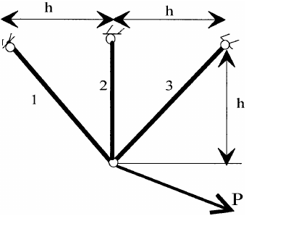

Bar-Truss Problem
Young’s modulus equation is $\frac{F}{A}=Y\frac{ΔL}{L_{0}}$
Input: F = Applied Force
L= Length of Bar
A= Cross Section Area
E= Elastic Young modulus of bar
Fig : Four Bar Struss Problem

Slide 36
Introduction Financial Z-SCORE model
Case Study
Z = 1.2 X1 + 1.4 X2 + 3.3 X3 + 0.6 X4 + 1.0 X5
Z=Z-SOCRE.
The definitions of X1 to X5 are:
X1：Working capital / total assets
X2：Retained Earnings / Total Assets
X3：Pre-tax Net Income / Total Assets
X4：Shareholders Equity / Total liabilities
X5：Sales Amount / Total Assets

Slide 37
Sample data of 20 companies for Z Score Model
No | X1 | X2 | X3 | X4 | X5 | Y
1 | 0.016 | 0.177 | 0.4208 | 1.038 | 0.022 | 0
2 | 1.0957 | 0.19 | 0.2224 | 0.816 | 0.933 | 1
3 | 0.2543 | 0.206 | 0.5264 | 0.4 | 0.015 | 1
4 | 1.2257 | 0.224 | 0.3272 | 1.05 | 1.049 | 1
5 | 0.3872 | 0.228 | 0.2256 | 0.98 | 0.998 | 1
6 | 1.6066 | 0.231 | 0.2832 | 1.054 | 1.009 | 1
7 | 1.1594 | 0.252 | 0.3344 | 0.946 | 0.987 | 0
8 | 0.3424 | 0.26 | 0.3408 | 0.196 | 0.126 | 1
9 | 0.8604 | 0.261 | 0.2616 | 0.994 | 0.996 | 0
10 | 0.5107 | 0.264 | 0.2352 | 0.888 | 0.004 | 1
11 | 0.8981 | 0.271 | 0.1536 | 0.688 | 0.857 | 1
12 | 0.0878 | 0.275 | 0.2072 | 0.732 | 0.908 | 1
13 | 0.2384 | 0.297 | 0.2336 | 0.036 | 0.099 | 0
14 | 0.8591 | 0.308 | 0.4208 | 0.132 | 1.031 | 1
15 | 0.5861 | 0.309 | 0.1656 | 0.836 | 0.896 | 1
16 | 0.6329 | 0.311 | -0.24 | -0.134 | 0.611 | 0
17 | 0.6173 | 0.311 | 0.1256 | 0.714 | 0.848 | 0
18 | 0.7811 | 0.326 | 0.2896 | 0.834 | 0.909 | 1
19 | 0.3937 | 0.329 | 0.2552 | 0.024 | 0.493 | 0
20 | 0.1211 | 0.055 | 0.3744 | 1.142 | 1.077 | 1
Fig 3 : Sample data of 20 companies for Z Score Model

Slide 38
Output Z Score Model
Use the following sample data input ZSCORE models:
Z = 1.2 X1 + 1.4 X2 + 3.3 X3 + 0.6 X4 + 1.0 X5
2.3004 | 3.7374 | 2.5857 | 4.5432 | 3.1143
4.8273 | 4.4022 | 2.1431 | 3.8536 | 2.2954
3.2338 | 2.5213 | 1.5934 | 3.9610 | 3.0800
0.935 | 2.8670 | 3.7588 | 2.2826 | 3.2200
Figure :Output Z Score Model

Slide 39
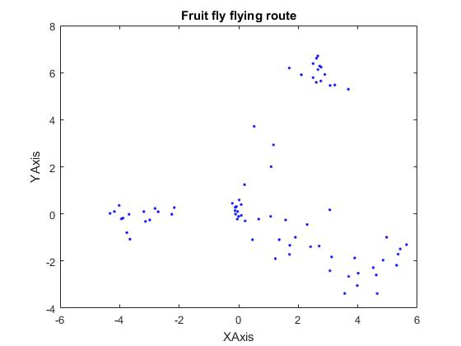
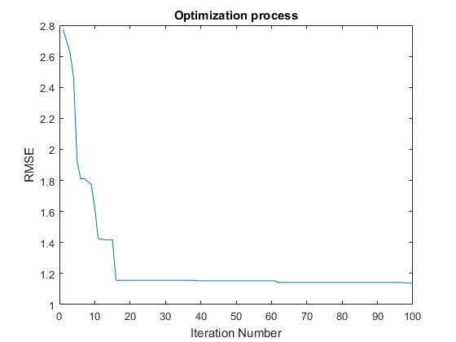
FFOA for ZSCORE MODEL
Fig : FFOA ZSCORE Model

Slide 40
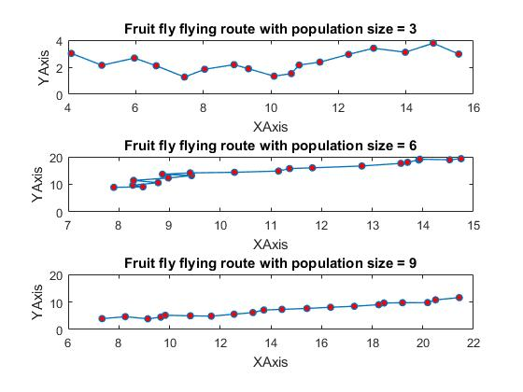
Swarm Population of FFOA
Fig ; Swarm Population of FFOA

Slide 41
Work Progress
DP- I :- Work Completed
Literature Survey
Synopsis
Problem Statement
DP- II :- Work Completed
Objective 1 : Design and Implementation of FFOA to CEC 2013.
Objective 2 : Analysis on FFOA Algorithm with CEC 2013

Slide 42
Work Progress
DP- III :- Work to be Completed
FFOA on CEC 2013 Result Analysis.
To Select Engineering Optimization Problem and Solve using FFOA.
DP- IV :- Work to be Completed
Paper Publication
Dissertation Report

Slide 43
References
[1] J. Q. Li, Q. K. Pan and K. Mao,” A Hybrid Fruit Fly Optimization Algorithm for the Realistic Hybrid Flowshop
Rescheduling Problem in Steelmaking Systems,” in IEEE Transactions on Automation Science and
Engineering, vol. 13, no. 2, pp. 932-949, April 216.
doi:10.1109/TASE.2015.2425404
[2] X. L. Zheng and L. Wang, "A Collaborative Multiobjective Fruit Fly Optimization Algorithm for the Resource
Constrained Unrelated Parallel Machine Green Scheduling Problem," in IEEE Transactions on Systems, Man,
and Cybernetics: Systems, vol. PP, no. 99, pp. 1-11. doi:10.1109/TSMC.2016.2616347
[3] K. Wu, J. Kang and X. Wang, "Research on Failure Prognostics Method of Electronic System Based on
Improved Fruit Fly Algorithm and Grey Fast Relevance Vector Machine," 2016 International Conference
on Intelligent Networking and Collaborative Systems (INCoS), Ostrawva, 2016, pp. 94-98. doi:10.1109/INCoS.2016.65
[4] K. Ohnishi, A. Fujiwara and M. Koeppen, "Non-swarm intelligence search algorithm based on the foraging
behaviors of fruit flies," 2016 IEEE Congress on Evolutionary Computation (CEC), Vancouver, BC, 2016,
pp. 1509-1516. doi:10.1109/CEC.2016.7743968

Slide 44
References
[5] Y. Han, Y. Jing and K. Li, "Multi-step prediction for the network traffic based on echo state network optimized
by quantum-behaved fruit fly optimization algorithm," 2017 29th Chinese Control And
Decision Conference (CCDC), Chongqing, 2017, pp. 2270-2274. doi:10.1109/CCDC.2017.7978893
[6] Q. Ma, Yuzhu He and F. Zhou, "Multi-objective fruit fly optimization algorithm for test point
selection," 2016 IEEE Advanced Information Management, Communicates, Electronic and Automation
Control Conference (IMCEC), Xi'an, 2016, pp. 272-276. doi:10.1109/IMCEC.2016.7867215
[7] S. Luo, K. Sarabandi, L. Tong and L. Pierce, "A LS-SVM-based classifier with Fruit Fly Optimization
Algorithm for polarimetric SAR images," 2016 IEEE International Geoscience and Remote Sensing
Symposium (IGARSS), Beijing, 2016, pp. 1859-1862. doi:10.1109/IGARSS.2016.7729477
[8] N. Mhudtongon, C. Phongcharoenpanich and K. Watanabe, "Linear antenna synthesis with maximum
directivity using improved fruit fly optimization algorithm," 2016 URSI International Symposium on
Electromagnetic Theory (EMTS), Espoo, 2016, pp. 698-701. doi: 10.1109/URSI-EMTS.2016.7571494
[9] Wen-Tsao Pan. A New Wvolutionary Computation-Fruit Fly Optimization Algorithm.,2016
[10] L. Polo-López, J. Córcoles and J. A. Ruiz-Cruz, "Fruit fly optimization algorithm for passive waveguide
devices," 2017 IEEE MTT-S International Conference on Numerical Electromagnetic and Multiphysics
Modeling and Optimization for RF, Microwave, and Terahertz Applications (NEMO), Seville, 2017, pp. 4345. doi: 10.1109/NEMO.2017.7964181

Slide 45
References
[11] S. Zhang, Y. Chen and Y. Geng, "Fruit Fly Algorithm Based on Extremal Optimization," 2016 12th
International Conference on Computational Intelligence and Security (CIS), Wuxi, 2016, pp. 534-537. doi: 10.1109/CIS.2016.0130
[12] A. Dey, T. Sarkar and S. Ali, "Fruit Fly algorithm based clustering protocol in wireless sensor networks,“
2016 9th International Conference on Electrical and Computer Engineering (ICECE), Dhaka, 2016,
pp. 295-298. doi:10.1109/ICECE.2016.7853914
[13] J. Jiang, H. Wang, G. Tang, L. Song and P. Chen, "Fault diagnosis method based on minimum entropy
deconvolution and fruit fly optimization algorithm," 2016 10th International Conference on Sensing
Technology (ICST), Nanjing, 2016, pp. 1-4. doi: 10.1109/ICSensT.2016.7796320
[14] Bo Xing,Wen-Jing Gao. A Innovative Computational Intelligence: A Rough Guide to 134 Clever
Algorithms ,Springer, 2016.
[15] Lin Wang, Yuanlong Shi, Shan Liu, An improved fruit fly optimization algorithm and its
application to joint replenishment problems, Expert Systems with Applications, Volume 42, Issue 9, 2015,
Pages 4310-4323, ISSN 0957-4174.
[16] H. Iscan and M. Gunduz, "A Survey on Fruit Fly Optimization Algorithm," 2015 11th International
Conference on Signal-Image Technology & Internet-Based Systems (SITIS), Bangkok, 2015, pp. 520-527. doi: 10.1109/SITIS.2015.55

Slide 46
References
[17] X. l. Zheng and L. Wang, "A Pareto based fruit fly optimization algorithm for task scheduling and
resource allocation in cloud computing environment," 2016 IEEE Congress on Evolutionary Computation
(CEC), Vancouver, BC, 2016, pp. 3393-3400. doi: 10.1109/CEC.2016.7744219
[18] H. Zhao, Q. Zhang, L. Zhang and Y. Wang, "A Novel Sensor Deployment Approach Using Fruit Fly
Optimization Algorithm in Wireless Sensor Networks," 2015 IEEE Trustcom/BigDataSE/ISPA, Helsinki,
2015, pp. 1292-1297. doi: 10.1109/Trustcom.2015.520
[19] J. Kang, K. Wu, K. Chi and X. Wang, "A Novel Multi-class Classification Approach Based on Fruit Fly
Optimization Algorithm and Relevance Vector Machine," 2016 International Conference on Intelligent
Networking and Collaborative Systems (INCoS), Ostrawva, 2016, pp. 402-406. doi: 10.1109/INCoS.2016.67
[20] L. Yin, X. Li, L. Gao and C. Lu, "A new improved fruit fly optimization algorithm for traveling salesman
problem," 2016 Eighth International Conference on Advanced Computational Intelligence (ICACI), Chiang
Mai, 2016, pp. 21-28. doi: 10.1109/ICACI.2016.7449797

Slide 47
References
[21] R. Cheng, M. Li, Ye.Tian, X. Zhang, S.Yang,Yaochu Jin ,X. Yao. January 2016
Benchmark Function for CEC’2017 Competition on Evolutionary Many-Objective.
[22] A. A.Gazali, and S. Fujimura,”Localization strategy for island model genetic algorithm to preserve
population diversity.” In Computer and Information Science ,Vol. 719, pp. 149-161. Studies in
Computational Intelligence; Vol. 719. Springer Verlag. doi: 10.1007/978-3-319-60170-0_11
[23] S. He, Q. H. Wu and J. R. Saunders, "Group Search Optimizer: An Optimization Algorithm Inspired by
Animal Searching Behavior," in IEEE Transactions on Evolutionary Computation, vol. 13, no. 5, pp.
973-990, Oct. 2009. doi: 10.1109/TEVC.2009.2011992
[24] “P. N. Suganthan's Homepage.” Relational Database Design, www.ntu.edu.sg/home/epnsugan/.
[25] “Dr. Wei-Yuan Lin Research.” Dr. Wei-Yuan Lin Research, www.flyfoa.com/.
[26] “Virtual Library of Simulation Experiments:” Wellness Quiz - Health & Counselling - Simon Fraser
University, www.sfu.ca/~ssurjano/optimization.html.
[27] “SwMATH.” ABC - Mathematical Software - SwMATH, www.swmath.org/software/10950.

Slide 48
References
[28] J. Hu, C. Wang, C. Liu and Z. Ye, "Improved K-means algorithm based on hybrid fruit fly optimization
and differential evolution," 2017 12th International Conference on Computer Science and Education
(ICCSE), Houston, TX, 2017, pp. 464-467.
[29] Qingfeng Ma, Yuzhu He and Fuqiang Zhou, "Multi-objective fruit fly optimization algorithm for test
point selection," 2016 IEEE Advanced Information Management, Communicates, Electronic and Automation
Control Conference (IMCEC), Xi'an, 2016, pp. 272-276.
[30] S. Zhang, Y. Chen and Y. Geng, "Fruit Fly Algorithm Based on Extremal Optimization," 2016 12th International
Conference on Computational Intelligence and Security (CIS), Wuxi, 2016, pp. 534-537.
[31] M. Takeuchi, H. Matsushita, Y. Uwate and Y. Nishio, "Firefly algorithm existing leader fireflies," 2016 IEEE Asia
Pacific Conference on Circuits and Systems (APCCAS), Jeju, 2016, pp. 313-316.
[32] H. Peng, Z. Wu and C. Deng, "Enhancing Differential Evolution with Commensal Learning and Uniform Local
Search," in Chinese Journal of Electronics, vol. 26, no. 4, pp. 725-733, 7 2017.
[33] A. Panda, R. Mallipeddi and S. Das, "Particle swarm optimization with a modified learning strategy and blending
crossover," 2017 IEEE Symposium Series on Computational Intelligence (SSCI), Honolulu, HI, 2017, pp. 1-8.
[34] “P. N. Suganthan's Homepage.” Relational Database Design, www.ntu.edu.sg/home/epnsugan/.
[35] “Dr. Wei-Yuan Lin Research.” Dr. Wei-Yuan Lin Research, www.flyfoa.com/.
[36] “Virtual Library of Simulation Experiments:” Wellness Quiz - Health & Counselling - Simon Fraser University,
www.sfu.ca/~ssurjano/optimization.html.
[36] “SwMATH.” ABC - Mathematical Software - SwMATH, www.swmath.org/software/10950.

Slide 49
Acknowledgements
I am highly indebted to my project guide Dr. A. J. Umbarkar, Assistant Professor, Information Technology for their guidance and constant supervision as well as for providing necessary information regarding the project & also for their support in completing the project.

Slide 50
Acknowledgements
I would like to express my sincere gratitude to Dr. R. R. Rathod, Assistant Professor, Information Technology for their kind co-operation and encouragement which help me in completion of this project.

Slide 51
Acknowledgements
I would like to special gratitude to Dr. S. P. Sonavane, Head of Department, Information Technology for their encouragement and more over for their timely support and guidance till the completion of our project work.

Slide 52
Acknowledgements
Also I would like to thank Mr. S.B.Darade for his assistance, help during the preparation of the project work .

Slide 53
Acknowledgements
I am thankful to and fortunate to get constant encouragement, support and guidance from all Teaching staffs of Department of IT which helped me in successfully completing my project work. Also, I would like to extend my sincere esteems to all staff in laboratory for their timely support.

Slide 54
Acknowledgements
My thanks and appreciations also go to my colleague in developing the project and people who have willingly helped me out with their abilities. Their enthusiasm and regards have really boosted my motto because of which I will be able to complete my work.

Slide 55
Acknowledgements
My acknowledgement would be incomplete without thanking the biggest source of my strength, my family. The blessings of my parents.

Slide 56
Parameter Setting
Sr. No. | Parameters | Value
1 | Design Variables | 10, 30, 50
2 | Population Size | 100
3 | Number of Iterations | 10000
4 | Number of Function Runs | 51
5 | Total Functions | 28
Sr. No. | Performance Evaluation
1 | Mean
2 | Best
3 | Worst
4 | Standard Deviation
5 | t-Test
6 | Optimized value
7 | Number of evaluations
Table 2: Parameters Used
Table 3: Performance Evaluation

Slide 57
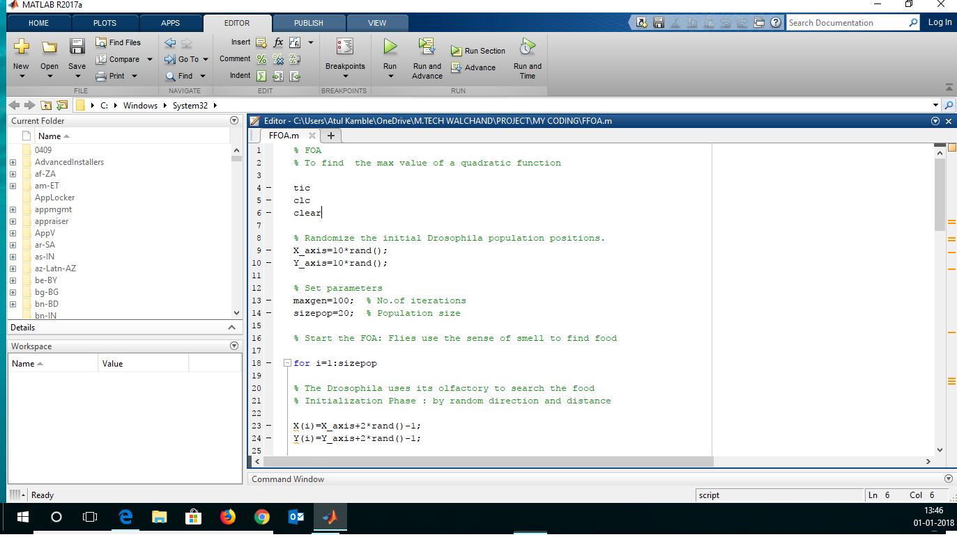
MATLAB CODE SCREENSHOT

